Slide 1
Software Development Process
Mark Woyna
October 4, 2005

Slide 2
Goals
Incorporate the best practices of iterative and agile methodologies into a customized process that fits CBOE’s business climate, corporate culture, and constraints
  Effectively use time-boxed development to drive the completion of feature development and delivery
  Increase visibility into team progress and facilitate communication between team members in order to effectively share knowledge and mitigate risks
  Increase accountability and maintain team focus

Slide 3
Responsibilities
Development Teams
  Focus on short-term (Iteration) objectives, i.e. delivering completed features
Development Team Manager(s) (Tier Leads)
  Remove impediments and distractions for the team in order to achieve the team’s goals
  Responsible for the completion of assigned tasks by members of their tier
Management
  Maintain a focus on long-term goals
  Set objectives for development teams
  Allocate resources to teams to meet the goals

Slide 4
Roles
Development Roles
  Tier Lead
  Tier Manager
  Iteration Manager
  Developer
Technical Roles
  Domain Expert
  Feature Owner
  Technical Manager

Slide 5
Tier Lead
Description
  The tier lead manages the daily activities of a development team (within their tier) during an iteration
Responsibilities
  Keep the development team focused and effective
  Work with the team to identify tasks necessary to complete iteration features
  Ensure the completion of features within the iteration
  Communicate risks to the iteration and tier managers as soon as they arise
Tasks
  Lead a short, focused daily meeting to communicate daily activities to the entire team
  Participate in prioritization of features
  Participate in the identification and estimation of tasks for each feature
  Assign tasks to tier members
  Manage the iteration task list for their tier
  Remove impediments or escalate impediments to the iteration and tier managers
  Ensure team members communicate effectively with tier managers, e.g. to contribute / lead design sessions and to review code

Slide 6
Tier Manager
Description
  The tier manager plans and manages tier-level activities across multiple development teams during an iteration
Responsibilities
  Work with the tier leads to identify tasks necessary to complete iteration features
  Keep the development teams focused and effective
  Ensure the completion of features within the iteration
  Communicate risks to the iteration manager as soon as they arise
Tasks
  Participate in prioritization of features
  Participate in the identification and estimation of tasks for each feature
  Assign tasks to tier members
  Coordinate activities with tier leads
  Escalate project risks to the iteration managers
  Evaluate team members at the end of each iteration
  Assist iteration manager with iteration planning and long-term planning

Slide 7
Iteration Manager
Description
  The iteration manager plans and manages activities across multiple development teams during an iteration as well as plans iteration and long-term activities beyond current iteration
Responsibilities
  Ensure iteration and project success across development teams .
  Manage iteration plan and long-term prioritized feature list
Tasks
  Manage the iteration plan and long-term prioritized feature list
  Establish realistic expectations and timelines across projects and teams
  Allocate resources to meet business objectives
  Work with domain experts, feature owners and project stakeholders to plan iterations and establish long-term goals and objectives
  Remove impediments escalated by the tier leads .

Slide 8
Developer
Description
  The developers on a team focus on meeting short-term iteration objectives by building high quality code
Responsibilities
  Build high quality software that maximally meets business needs.
  Communicate effectively with tier leads and managers to maximize team efficacy .
Tasks
  Assist tier lead with breaking features down into tasks
  Assist tier leads with estimating tasks
  Report accomplishments and impediments at daily meeting
  Write code and required documentation

Slide 9
Domain Expert
Description
  The domain expert provides expertise in a specific area of business
Responsibilities
  Use knowledge of industry and business practices to clarify and refine requirements.
  Work with iteration manager to ensure that iteration plan meets business objectives.
  Work with development teams to ensure that functionality meets business needs
Tasks
  Represent business priorities during iteration planning.
  Act as a proxy for the actual end user during development
  Develop requirement specifications
  Work with iteration managers to prioritize features and development tasks based on business expertise

Slide 10
Feature Owner
Description
  The feature owner serves as a domain expert with additional management responsibility and accountability for features articulated in a chartered system project
Responsibilities
  Represent chartered project objectives
Tasks
  Represent chartered project goals during planning and development
  Work with project stakeholders to establish and articulate project objectives
  Facilitate requirements gathering, documentation and information dissemination
  Resolve scope and requirements issues

Slide 11
Technical Manager
Description
  The technical manager provides technical expertise and leadership in a specific architectural tier (e.g. server, client), or software layer (e.g. middleware), and guides development staff in the design, implementation and support of functionality within that tier
Responsibilities
  Ensure architectural integrity, reliability, and quality
  Provide technical design and implementation expertise in iteration and long-term planning activities as well as development iterations.
  Ensure staff career development and training
Tasks
  Ensure tier quality
  Define technical requirements
  Develop staff technical skills
  Plan performance and reliability improvements
  Participate in planning and prioritizing feature development

Slide 12
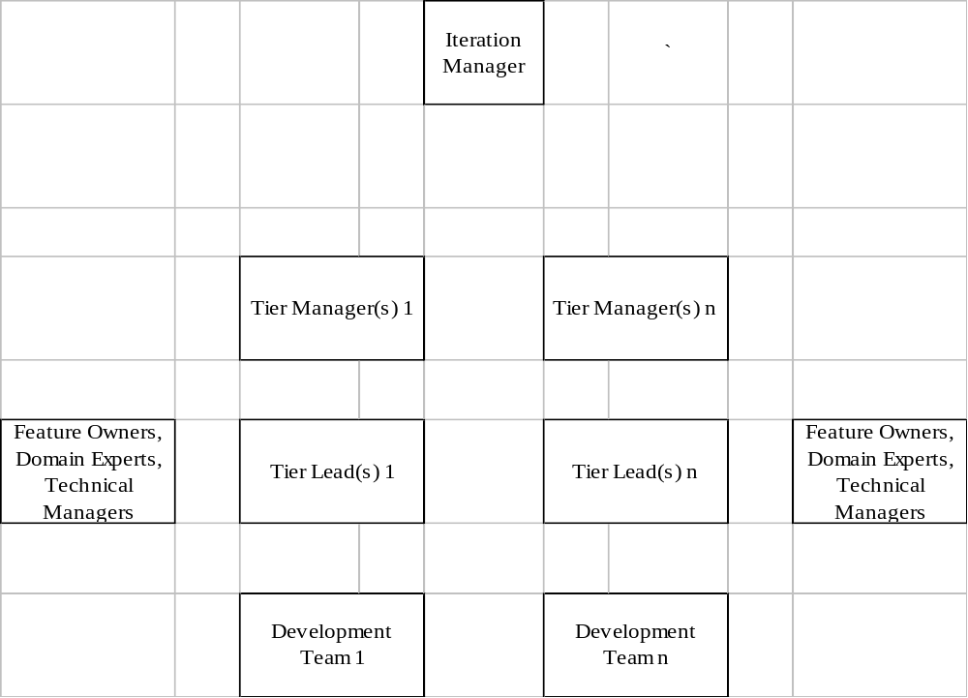
Organizational Structure

Slide 13
New Feature Development Teams
Implement new functionality as articulated in the prioritized feature list
New features are likely to have originated in a project charter or as an independent enhancement request
Deliver “production quality” code at the end of each iteration
Team members will be temporarily assigned to SWAT Team during scheduled primary and secondary support weeks
  Time is accounted for during iteration planning, i.e. no surprises

Slide 14
SWAT Teams
Responsible for everything but implementing new features*
  Production Support (primary and secondary)
  Critical defect removal
  Testing support (ATG, ITG, API)
  Development Support
  *Minor enhancements
  *Time critical features
  Tool building and automation
  Completion of rollout activities
Rollout Teams
  Focused on getting a set of completed features into production
  Completion and submission of documentation (to IRB)
  Roll into the general SWAT Team when finished

Slide 15
Resource Allocation
Iteration managers create and maintain the plan for resource allocation in order to best meet CBOE objectives
  Ensure adequate production support
  Build highest priority functionality (as outlined in the prioritized feature list)
  Effectively put new functionality into production
    Some staff involved in the development of the functionality move to the SWAT team charged with putting that functionality into production
  Maintain team stability
  Grow staff
    Team members may be rotated to broaden exposure to CBOE architecture, systems and IT activities.

Slide 16
Team Migration - General
i₀
i₁
i₂
i_{n}
Development Team
Development Team
Development Team
...
1/3
1/3
1/3
1/3
1/3
1/3
SWAT Team
SWAT Team
SWAT Team
1/3
1/3
1/3

Slide 17
Iteration Management Processes
Iterations are short time-boxed period (4 weeks) during which development occurs. Iteration length is fixed; work not completed during the iteration rolls into a later iteration. Iterations are never extended, but are managed to this fixed time-box.
Iteration Planning (During preceding iteration)
Iteration Kickoff
Intra-Iteration Management
Iteration Close

Slide 18
Iteration Planning
Feature Planning
  Easily and continually incorporate new project charters and new requirements into the prioritized feature list
  Efficiently meet the goals of each particular planning stage by breaking down and estimating functionality to the appropriate level
Resource Planning
  Effectively allocate resources to iterations to maximally meet business priorities
  Use metrics gathered during development to forecast project timelines and lay out features into iterations
Iteration Preparation
  Provide a description of each feature selected for an iteration
  Define requirements/acceptance test specifications for each feature
  Define the high-level architecture for the selected features

Slide 19
Diagram: Iteration Process Overlaid with Projects
Iterations →
i₀
i₁
i₂
i₃
...
i_{n}
i_{n+1}
...
Projects ↓
p₀
p₁
p₂
...
Enhancements
Defects

Slide 20
Iteration Kickoff
An all team meeting rapidly focusing the team on a new iterations’s features and tasks
Goals
  Gain a common understanding of all functionality to be worked on during the iteration, including feedback from the previous iteration
  Break functionality down into tasks, providing just enough information to estimate tasks and allocate work
  Ensure that a reasonable amount of work is slated for the iteration and that the highest priority features are allocated to the iteration
Participants
  Tier Managers and Leads
  Domain Experts
  Technical Managers
  Developers
  Feature Owner and Iteration Manager

Slide 21
Intra-Iteration Management
Goals
  Keep the development team focused on tasks
  Ensure effective communication (including formal or informal design sessions and code reviews)
  Escalate issues, impediments and risks to the iteration
  Use time-boxed development to measure how much work the team is able to do and use those metrics to forecast long-term schedules
Participants
  Tier Managers and Leads
  Developers
  Iteration Manager

Slide 22
Daily Meeting
The daily meeting is a short meeting held at the same time and in the same place. Its purpose is for each developer to communicate succinctly to the team
  What he/she accomplished yesterday
  What he/she will work on today (including tasks outside the iteration task list)
  What impediments inhibit the completion of her tasks
  What new tasks were identified for each feature
Used to provide data for iteration task list
Tier leads report the status of each open impediment
The daily meeting is neither a design meeting nor an issue resolution meeting.
  Such meetings may be scheduled during or immediately after the daily meeting

Slide 23
Iteration Task List
Identify each iteration feature
Identify each task associated with each feature
Identify each developer responsible for each task
Estimate work remaining for each task
Used to product iteration “burn-down” graph
  Remaining work during each day of iteration

Slide 24
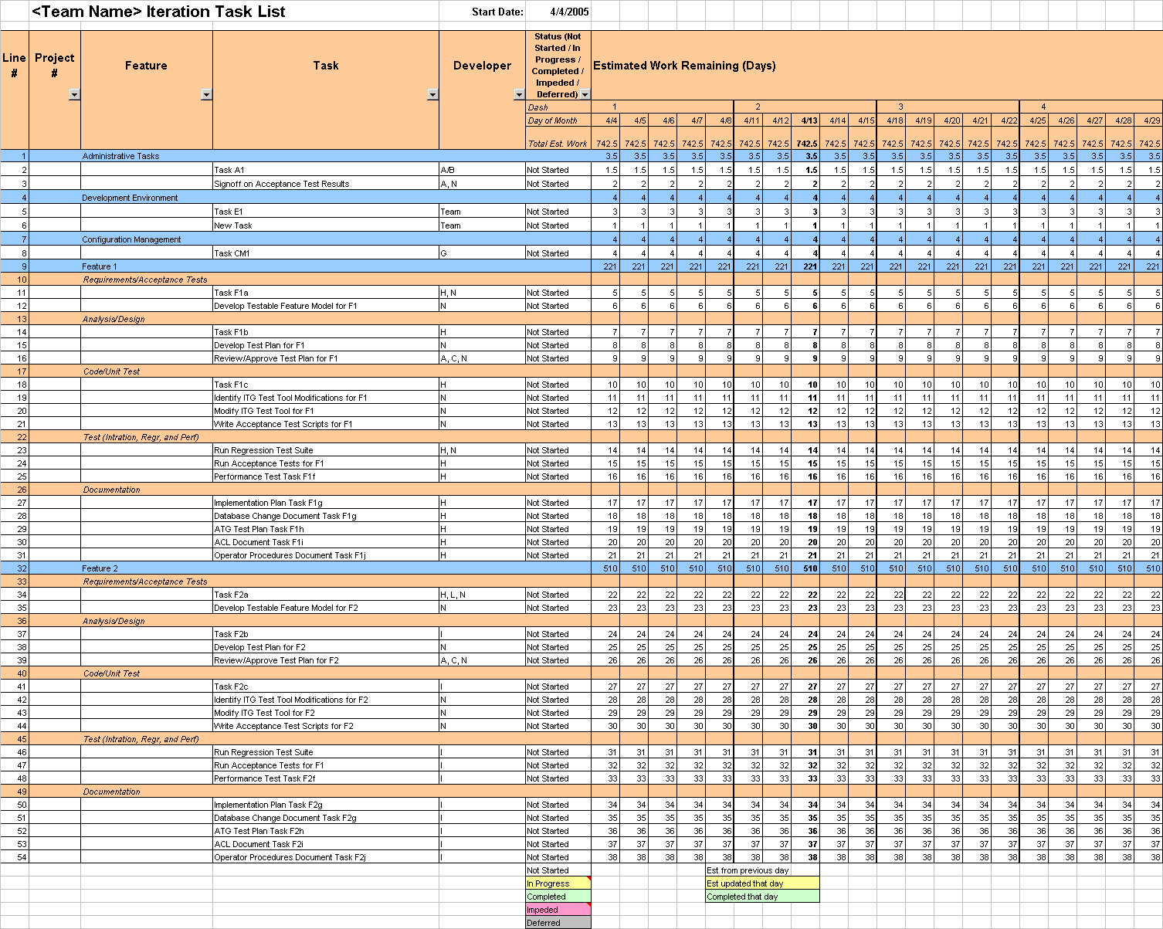
Iteration Task List Example

Slide 25
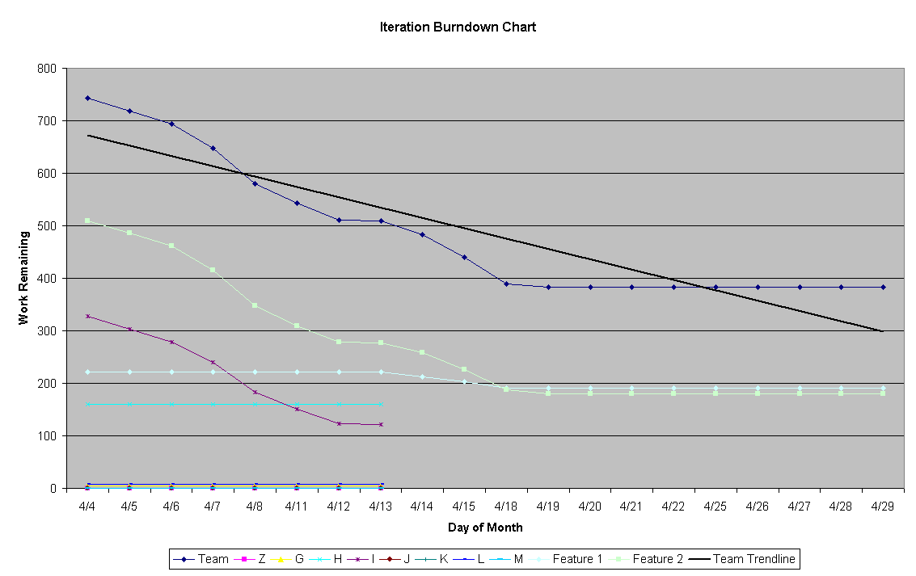
Iteration Burn-down Graph

Slide 26
Iteration Close
A final status is determined for each task and each feature worked on during the iteration
  Domain experts and feature owners may review completed features.
  Feedback in the form of enhancements, refinements or improvements to the functionality is incorporated into subsequent iterations through the iteration manager and the prioritized feature list
Goals
  Determine final status for each feature and task in the iteration task list
  Review completed functionality to ensure business needs are met
  Collect feedback on the development process
  Calculate team capacity
Participants
  Tier Managers and Leads
  Domain Expert and/or Feature Owner
  Technical Managers
  Developers
  Iteration Manager

Slide 27
Artifacts
Project Charter
Application Architecture Document
Requirements/Use Case Documents
Project Checklist
Prioritized Feature List
Iteration Resource Schedule
Acceptance Tests
Iteration Task List
Impediment List
Iteration Documentation
  Design Documents and Models (UML)
  Data Model (Logical)
  Database Build (DDL)
  IDL and DB Changes Documents
  End User Documents (e.g. Operator Procedures)
  Implementation Plan
  Test Plan (Acceptance Tests and Other System-level Tests)
  Configuration Document

